Slide 1
Regression: Session 1
Dr. Chetana Gavankar, Ph.D,
IIT Bombay-Monash University Australia
Chetana.gavankar@pilani.bits-pilani.ac.in

Slide 2
Session 1
Date – 10/11/2019
Time – 10am to 12pm

Slide 3
Topics to be covered
Introduction to Regression and Classification
Linear and Polynomial Regression
Overfitting
Error Function for Linear Regression
Introduction to Matrix Theory
Solving Simultaneous Equation with Matrices

Slide 4
Regression vs Classification
In Regression we assign input vector x to one or more continuous target variables t
Linear regression has simple analytical and computational properties
In Classification we assign input vector x to one of K discrete classes C_{k}, k = 1, . . . ,K
Common classification scenario: classes considered disjoint
Each input assigned to only one class
Input space is thereby divided into decision regions

Slide 5
Regression
y = f(x)
Training: given a training set of labeled examples {(x₁,y₁), …, (x_{N},y_{N})}, estimate the prediction function f by minimizing the prediction error on the training set
Testing: apply f to a never before seen test example x and output the predicted value y = f(x)
output
prediction function
features
Slide credit: L. Lazebnik
Notes:
Applications: • Predicting the stock market index based on economic factors • Forecasting precipitation based on characteristics of the jet stream • Projecting a company’s revenue based on the amount spent for advertisement

Slide 6
Machine Learning - Examples
Predicting price of a used car
Brand
Year (Mfg)
Engine Capacity
Mileage
Distance travelled
Cab?
Features / Attributes / Predictors
S.No | Brand | Year (Mfg) | Engine Capacity | Mileage | Distance travelled | Cab? | Price (in Rs.)
1. | Honda City ZX | 2008 | 1100 | 10.5 | 45000 | N | 3,50,000
2
3
4

Slide 7
Classification & Regression – Examples
Classification
Predicting whether a patient has a particular disease or not.
Hand written digit recognition
Email spam detection
Regression
Predicting house/property price
Predicting stock market price
Predicting sales of a product

Slide 8
Regression model
Relation between variables where changes in some variables may “explain” or possibly “cause” changes in other variables.
Explanatory variables are termed the independent variables and the variables to be explained are termed the dependent variables.
Regression model estimates the nature of the relationship between the independent and dependent variables.
Change in dependent variables that results from changes in independent variables, ie. size of the relationship.
Strength of the relationship.
Statistical significance of the relationship.

Slide 9
Simple or multiple regression model
(Education) x y (Income)
(Education) x₁
(Soft Skills) x₂
(Experience) x₃
(Age) x₄
Simple regression model
Multiple regression model
y (Income)

Slide 10
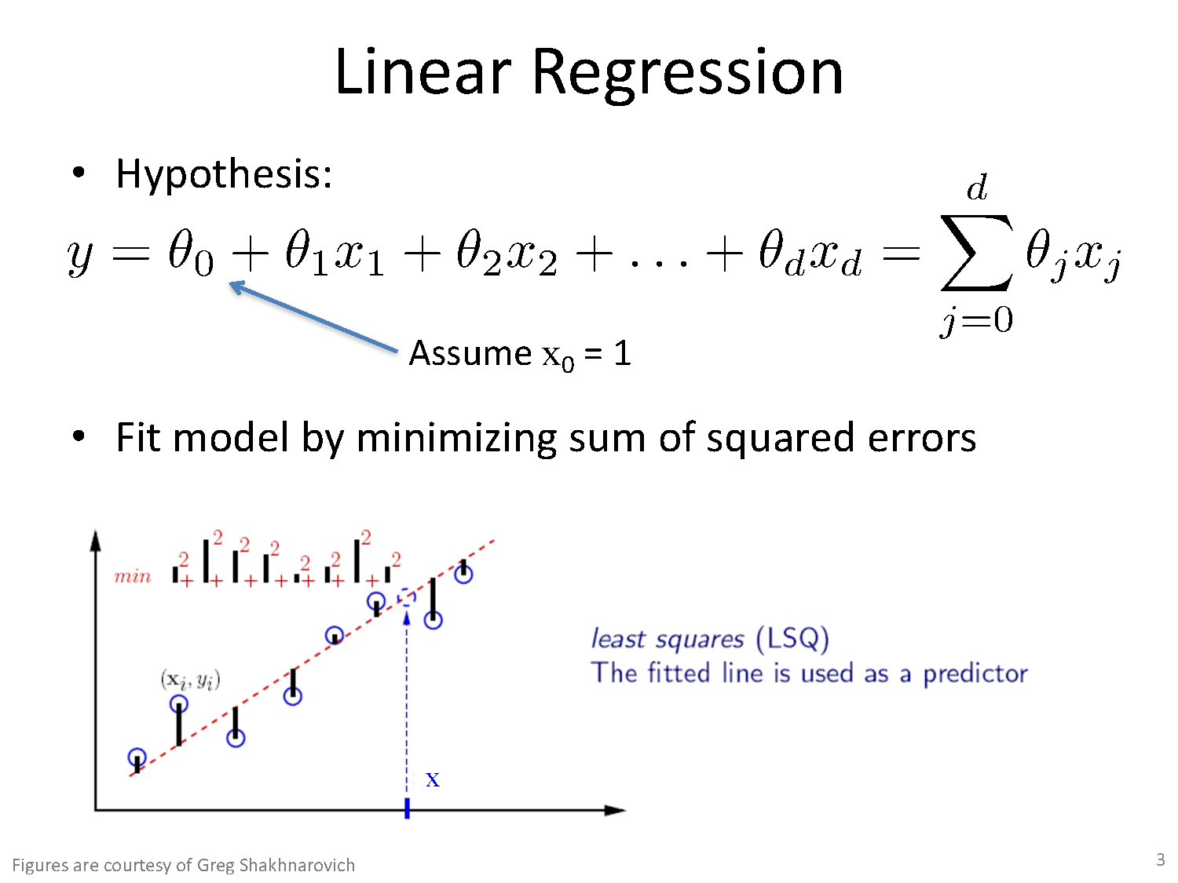

Slide 11
Housing Prices
Price
(in 1000s of dollars)
Size (feet²)
Supervised Learning
Given the “right answer” for each example in the data.
Regression Problem
Predict real-valued output

Slide 12
Training set of housing prices
Size in feet² (x) | Price ($) in 1000's (y)
2104 | 460
1416 | 232
1534 | 315
852 | 178
… | …
Notation:
m = Number of training examples
x’s = “input” variable / features
y’s = “output” variable / “target” variable

Slide 13
Regression Problem
Training Set
Learning Algorithm
Size of house
Estimated price
h

Slide 14
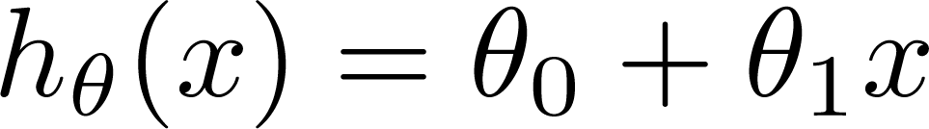

Training Set
Size in feet² (x) | Price ($) in 1000's (y)
2104 | 460
1416 | 232
1534 | 315
852 | 178
… | …
Hypothesis:
‘s: Parameters
How to choose ‘s ?

Slide 15
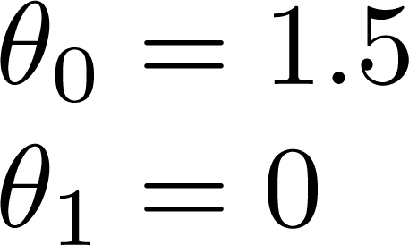
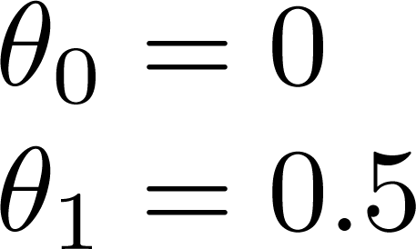
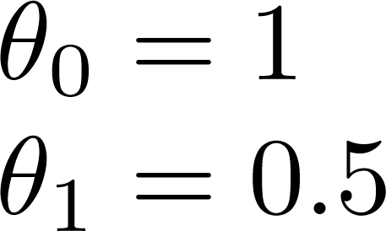
Linear regression with one variable
Univariate linear regression

Slide 16
Multiple features (variables).
Size (feet²) | Number of bedrooms | Number of floors | Age of home (years) | Price ($1000)
2104 | 5 | 1 | 45 | 460
1416 | 3 | 2 | 40 | 232
1534 | 3 | 2 | 30 | 315
852 | 2 | 1 | 36 | 178
… | … | … | … | …

Slide 17

Hypothesis
Previously:
h _{θ}(x) = θ₀ + θ₁x1 + θ₂x₂ + θ₃x₃ + θ₄x₄

Slide 18

Root-mean-square error (RMSE)
Root-mean-square deviation (RMSD) or RMSE
Measure of the differences between values (sample or population values) predicted by a model and the values observed
RMSE gives a relatively high weight to large errors
Useful when large errors are particularly undesirable
If you are trying to compare two models/estimators, then there is no significance to the square root.
Square root - trying to plot the error in terms of the same units as you made the estimators

Slide 19

Linear Regression Error Function
Mean Absolute Error (MAE): MAE measures the average magnitude of the errors in a set of predictions

Slide 20
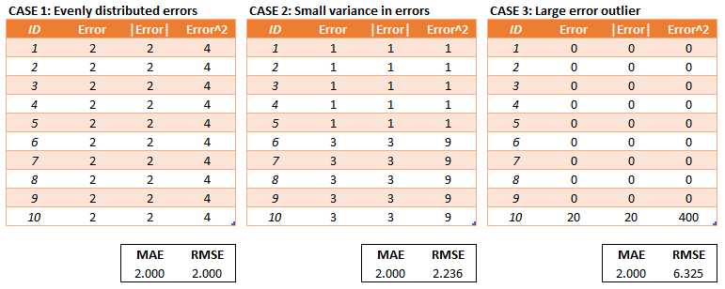
Linear Regression Error Function

Slide 21
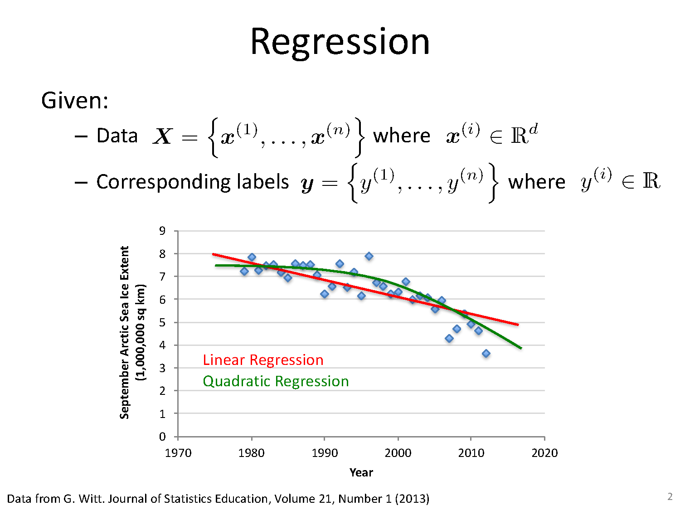
Geometric Approach

Slide 22
OVERFITTING

Slide 23
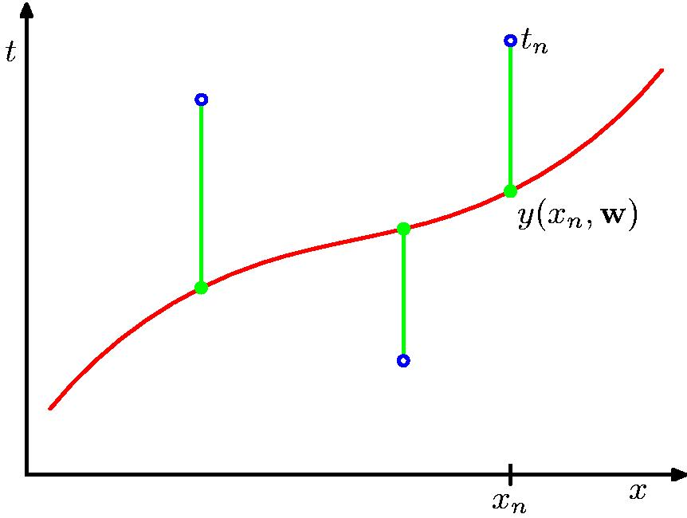
Root mean square Error Function

Slide 24
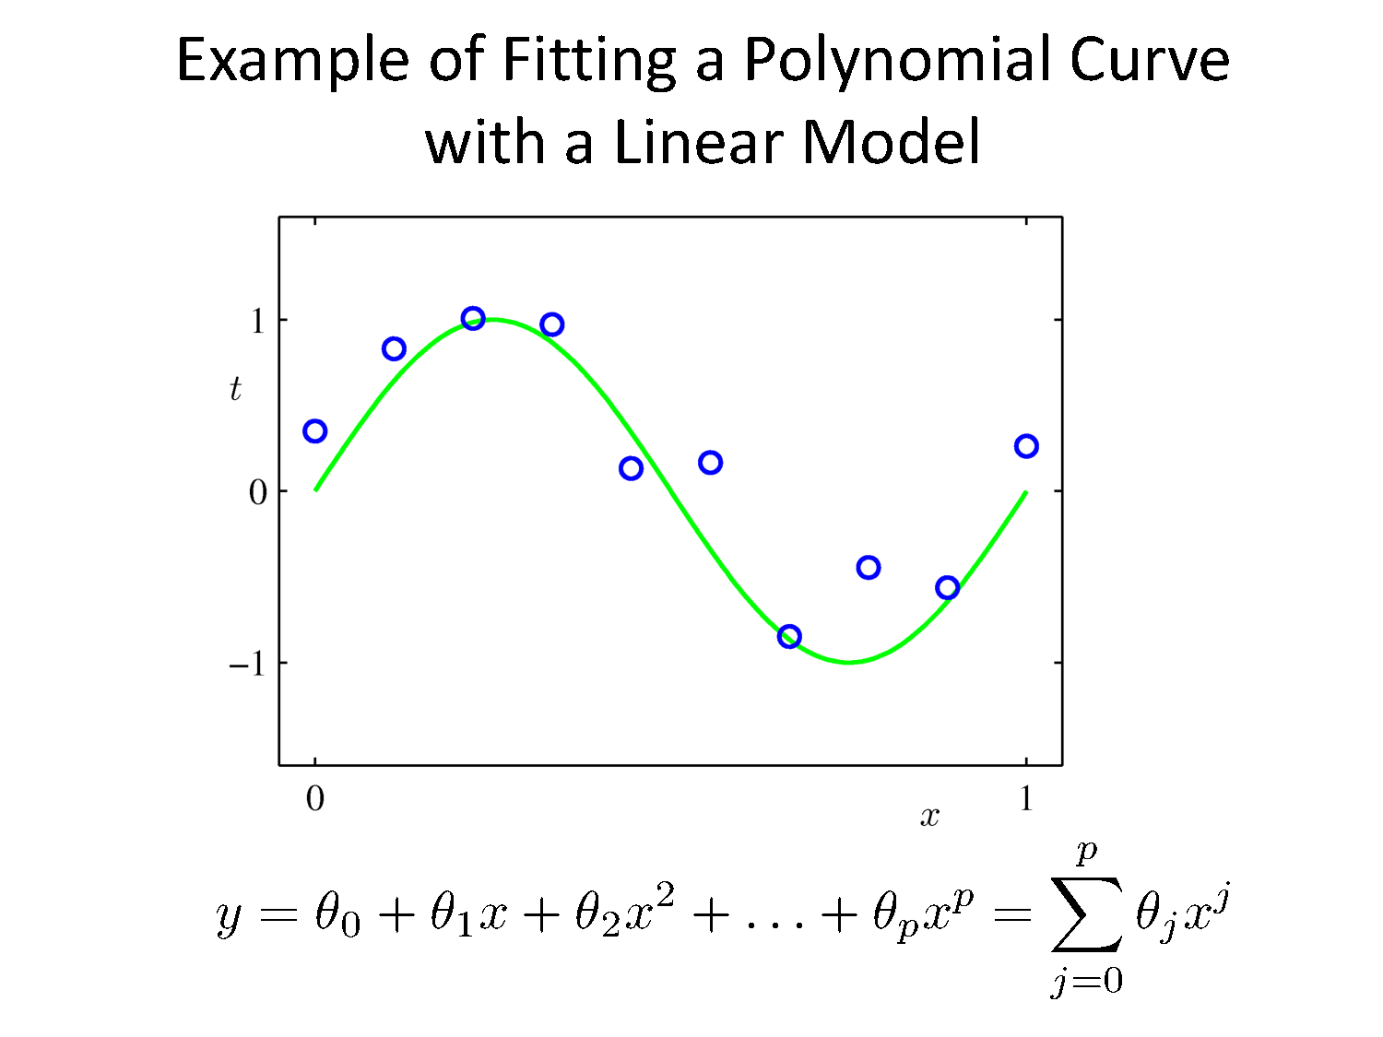

Slide 25
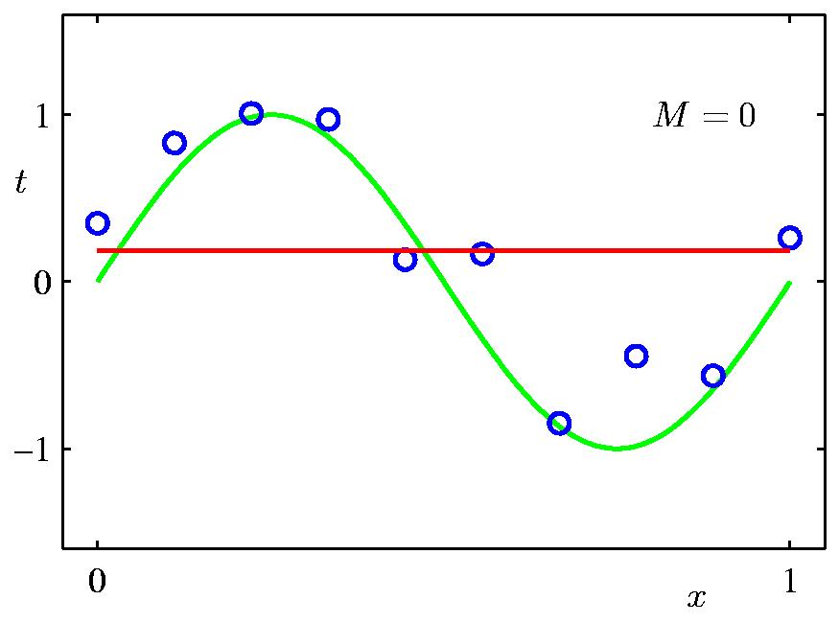
0th Order Polynomial

Slide 26
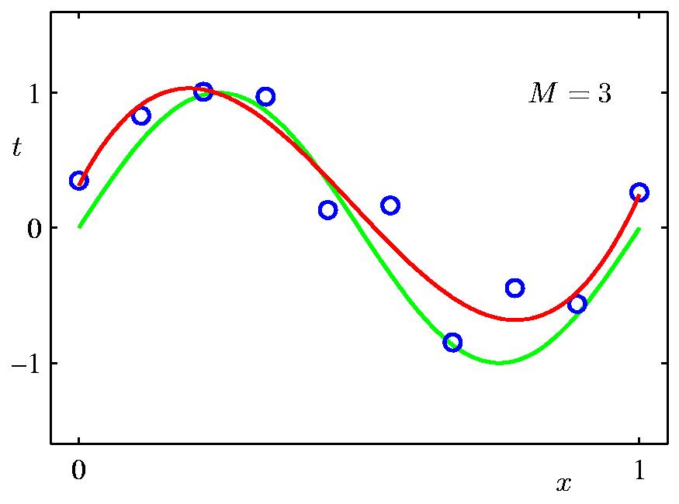
3rd Order Polynomial

Slide 27
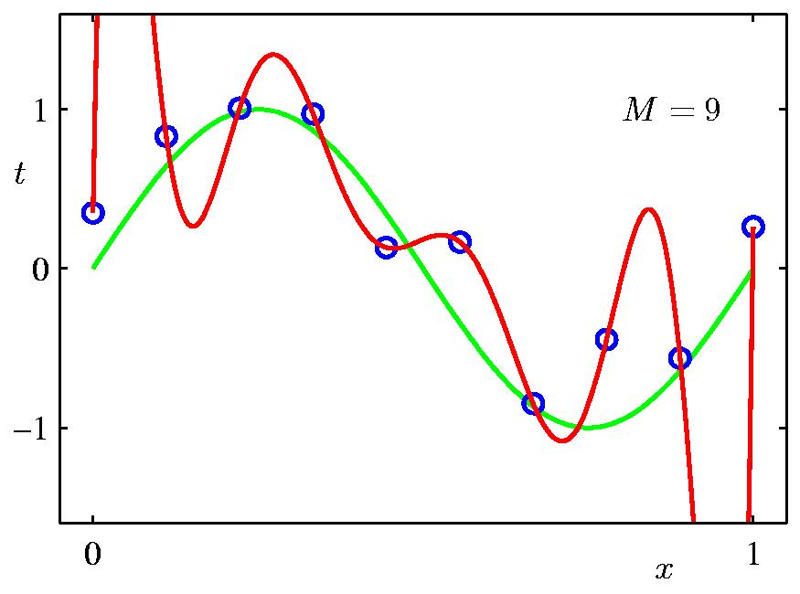
9th Order Polynomial

Slide 28
Introduction to Matrix Theory
See http://cs229.stanford.edu/section/cs229-linalg.pdf for more

Slide 29
Vectors
Collections of ordered numbers that represent movements in space, word counts, movie ratings, pixel brightness, etc.
Vector is a mathematical quantity that has magnitude and direction

Slide 30
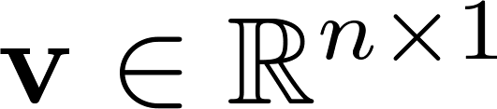
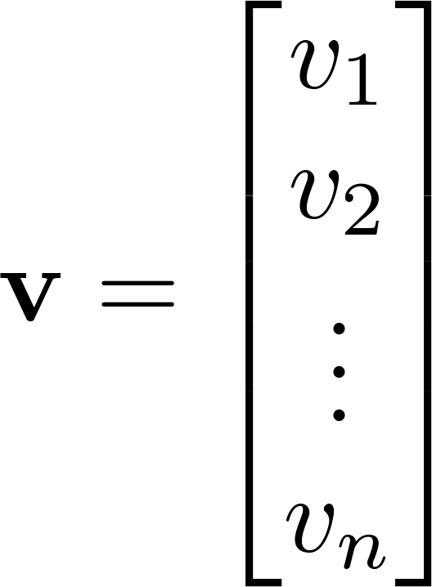
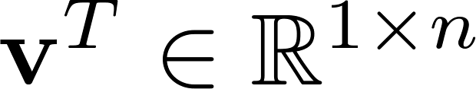
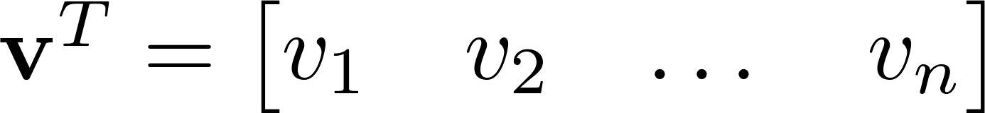

Vector
A column vector where
A row vector where
denotes the transpose operation

Slide 31
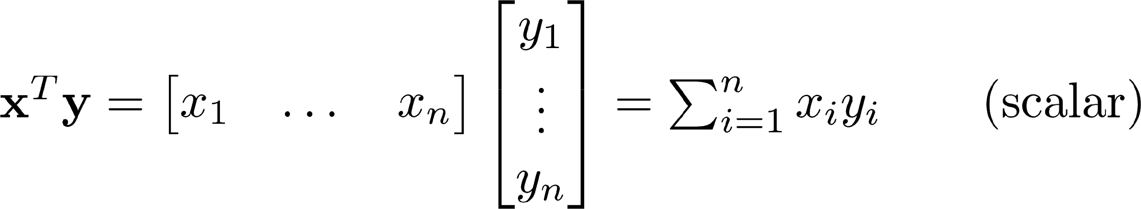
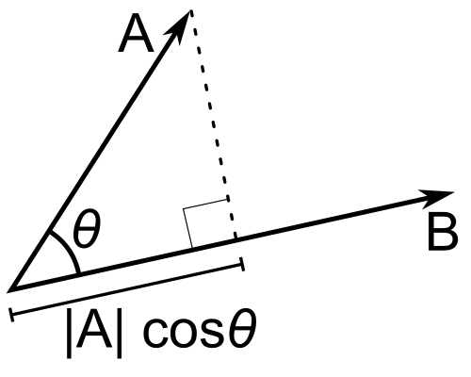
Inner Product
Multiply corresponding entries of two vectors and add up the result
If B is a unit vector, then A·B gives the length of A which lies in the direction of B (projection)
(if B is unit-length hence norm is 1)

Slide 32
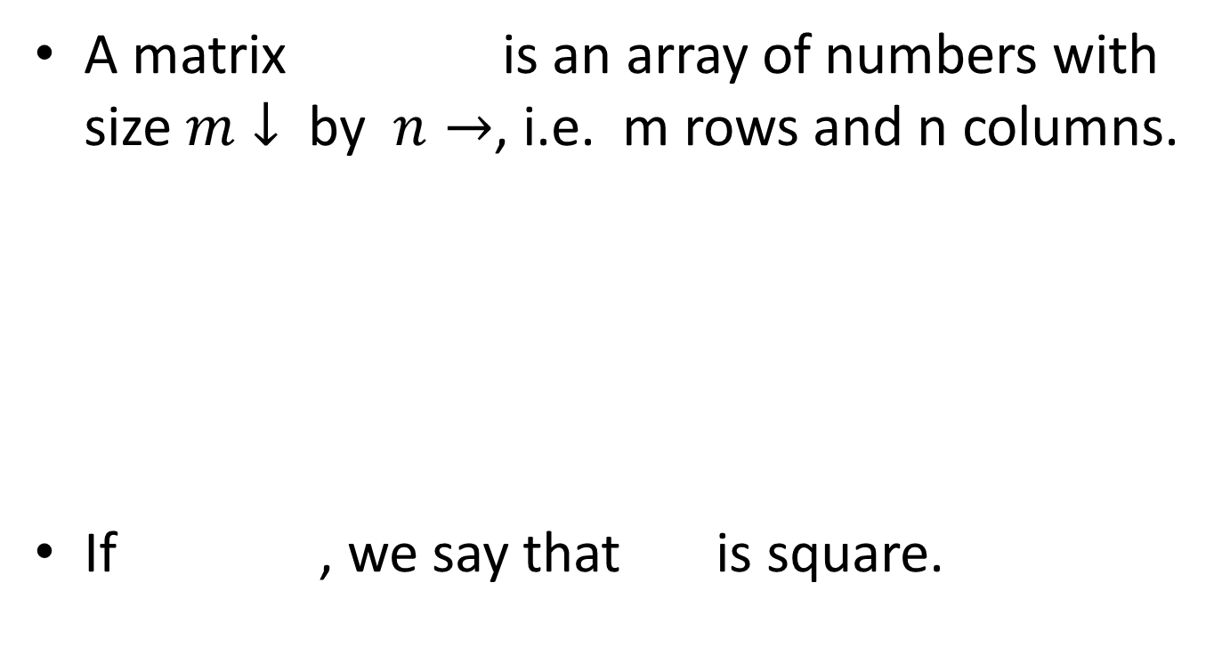
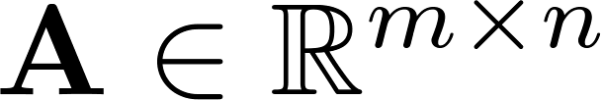
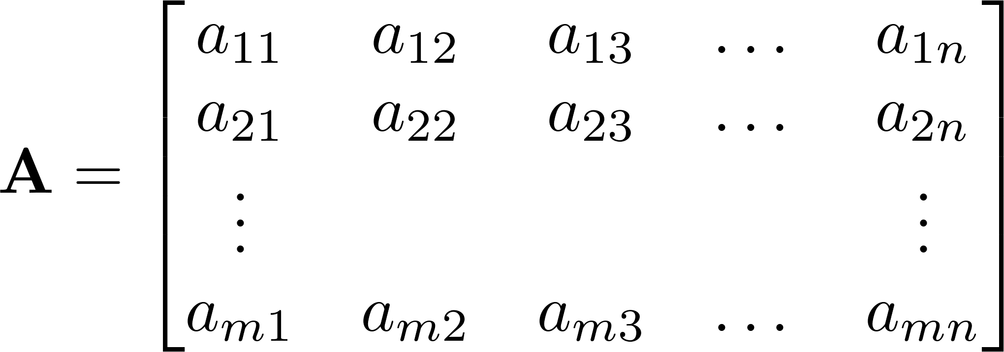


Matrix

Slide 33
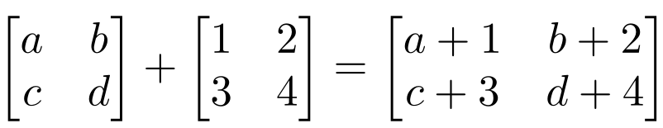
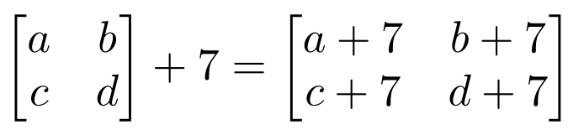
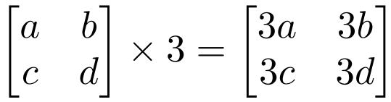
Matrix Operations
Addition
Can only add a matrix with matching dimensions, or a scalar.
Scaling

Slide 34
Matrix Multiplication
Let X be an axb matrix, Y be an bxc matrix
Then Z = X*Y is an axc matrix
Second dimension of first matrix, and first dimension of first matrix have to be the same, for matrix multiplication to be possible

Slide 35
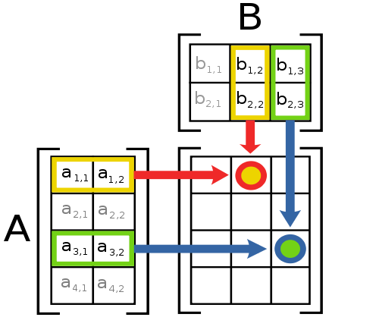
Matrix Multiplication
The product AB is:
Each entry in the result is (that row of A) dot product with (that column of B)

Slide 36
Matrix Operation Properties
Matrix addition is commutative and associative
A + B = B + A
A + (B + C) = (A + B) + C
Matrix multiplication is associative and distributive but not commutative
A(B*C) = (A*B)C
A(B + C) = A*B + A*C
A*B != B*A

Slide 37
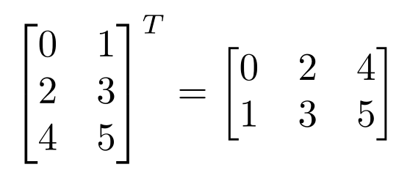
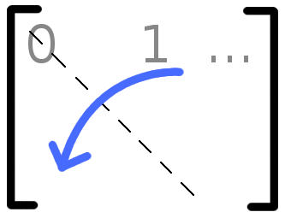

Matrix Operations
Transpose – flip matrix, so row 1 becomes column 1
A useful identity:

Slide 38
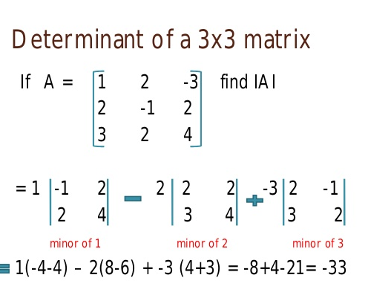
Determinant of matrix

Slide 39
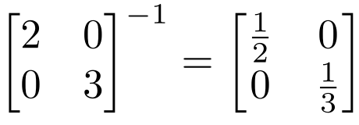
Inverse of Matrix
Given a matrix A, its inverse A⁻¹ is a matrix such that AA⁻¹ = A⁻¹A = I
E.g.
Inverse does not always exist. If A⁻¹ exists, A is invertible or non-singular.
A square matrix has an inverse if and only if it's determinant is non zero.
Inverse doesn’t exist for non-square matrices

Slide 40
Orthogonal Matrix
Orthogonal matrix is a square matrix whose columns and rows are orthogonal unit vectors (i.e., orthonormal vectors), i.e. QᵀQ=QQᵀ=I, where I is the identity matrix.
Matrix Q is orthogonal if its transpose is equal to its inverse: Qᵀ=Q⁻¹.

Slide 41
Linear independence
Suppose we have a set of vectors v₁, …, v_{n}
If we can express v₁ as a linear combination of the other vectors v₂…v_{n}, then v₁ is linearly dependent on the other vectors.
The direction v₁ can be expressed as a combination of the directions v₂…v_{n}. (E.g. v₁ = .7 v₂ -.7 v₄)
If no vector is linearly dependent on the rest of the set, the set is linearly independent.
Common case: a set of vectors v₁, …, v_{n} is always linearly independent if each vector is perpendicular to every other vector (and non-zero)

Slide 42
Matrix Rank
Column/row rank
col-rank(A)=no. of linearly independent columns
row-rank(A)=no. of linearly independent rows
Rank of a matrix is the number of linearly independent rows or columns (whichever is smaller).

Slide 43
Matrix Rank
Rank of a matrix denotes the information content of the matrix.
The lower the rank, the lower is the "information content".

Slide 44

Matrix Rank : Example
Matrix has rank 2: the first two columns are linearly independent, so the rank is at least 2,
the third column is a linear combination of the first two (the second subtracted from the first),
Rank must be less than 3, since it is 3 by 3 matrix

Slide 45
Solving Simultaneous Equation with Matrices
Let A be the coefficient matrix of a system of n linear
equations in n variables given by
AX = B
where X is the n x 1 matrix of variables and B is the n x 1 matrix of
numbers of the right-hand side of the equations.
If A exists,
then the system of equations has the unique solution
–1
–1
X = A B

Slide 46
Writing equations in Matrix form
Write the system of equations as a matrix equation AX = B,
with A as the coefficient matrix of the system.
AX = B:

Slide 47
Writing equations in Matrix form

Slide 48
Inverse Matrix – Adjoint Method

Slide 49
Steps to find inverse of matrix
Step 1: calculating the Matrix of Minors,
Step 2: then turn that into the Matrix of Cofactors,
Step 3: then the Adjugate, and
Step 4: multiply that by 1/Determinant.

Slide 50
Example – Inverse of matrix
A=
A square matrix has an inverse if and only if it's determinant is non zero.
First we find the determinant
|A| = 1*(1*4-3*2)-3(1*4-2*2)+1(1*3-1*2)
= -2-0+1
= -1

Slide 51

Step 1: Calculating the Matrix of Minors
Minor of a matrix A is the determinant of some smaller square matrix, cut down from A by removing one or more of its rows and columns.
Minors obtained by removing just one row and one column from square matrices (first minors) are required for calculating matrix cofactors

Slide 52
Matrix of minors
We will have to find a total of 9 minors.

Slide 53
Step 2: Matrix of Cofactors
The matrix of co-factors of 3 x 3 matrix is obtained by
Applying the above matrix on
Leads to Matrix of Cofactors

Slide 54
Step 3: Adjoint matrix
The final step is to find the transpose of matrix of cofactors:
This matrix is the adjoint matrix adj(A)

Slide 55
Step 4: Multiply that by 1/Determinant

Slide 56
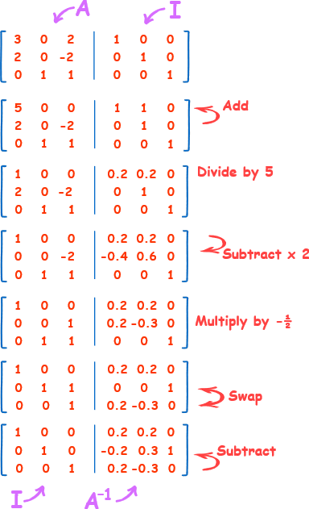
Linear Row operations

Slide 57
Practice Problem
Solve the given system using inverse matrices
Find
Solution:
(x, y, z) = (18, 118/3, 14)

Slide 58
Practice Problem
Solve the given system using inverse matrices
Find
Solution:
(x, y, z) = (3, –1/2, 1/2)

Slide 59
Linear Regression using normal equation
Normal Equation is an analytical approach to Linear Regression with a Least Square Cost Function.
We can directly find out the value of θ without using Gradient Descent.
Following this approach is an effective and a time-saving option when are working with a dataset with small features.

Slide 60
References
https://stackabuse.com/solving-systems-of-linear-equations-with-pythons-numpy/
https://scikit-learn.org/stable/modules/generated/sklearn.model_selection.train_test_split.html
https://www.datatechnotes.com/2019/02/regression-model-accuracy-mae-mse-rmse.html
https://www.geeksforgeeks.org/python-linear-regression-using-sklearn/

Slide 61
Thank You
4 April 2020

